Slide 1
Masking
Amy Bamford (Educational Psychologist), Courtney Ellis (Clinical Associate Psychologist) , Natalie Bailey (Assistant Psychologist) Lara Ollerenshaw (Assistant Psychologist)
With special thanks to the Guiding Voices Group who supported the development of this training
Notes:
Amy

Slide 2
Discussion: What is masking?
Notes:
Amy
Five minutes to discuss on tables – what is their understanding of masking?

Slide 3
What is masking?
Masking, or social camouflaging, is the conscious or unconscious suppression of natural behaviours, emotions, and personality traits to fit into social situations or conform to neurotypical expectations.
Masking supports you to hide who you are; this can lead to you feeling afraid to show the ‘real you’ leading you to mask even more.
Masking is often automatic and developed over time.
It is rarely a conscious choice — it is a learned survival strategy.
Masking can be absolutely exhausting!
Notes:
Amy

Slide 4
But… not all masking is equal
Masking in its broadest sense is something that many of us do at times. Whether this is at work; with family and/or friends; at the school gates; in an interview; or at a party.
Activity:
Think about a situation where you have had to mask or perform (job interview, parents’ evening, difficult meeting).
How long could you sustain that?
How did you feel afterwards?
What would happen if you had to do it all day/at work, every day?
Notes:
Courtney

Slide 5
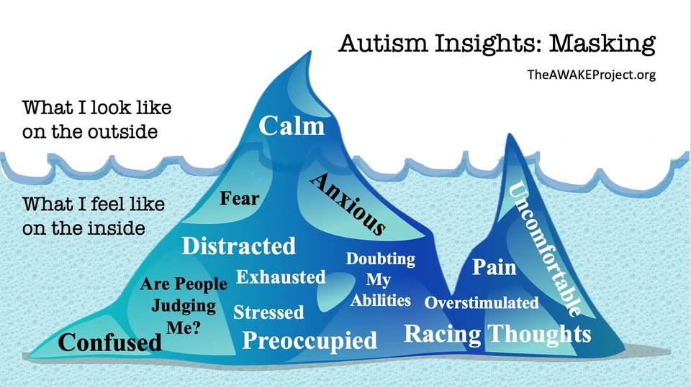
Masking iceberg
Masking might look like this…
Notes:
Courtney

Slide 6
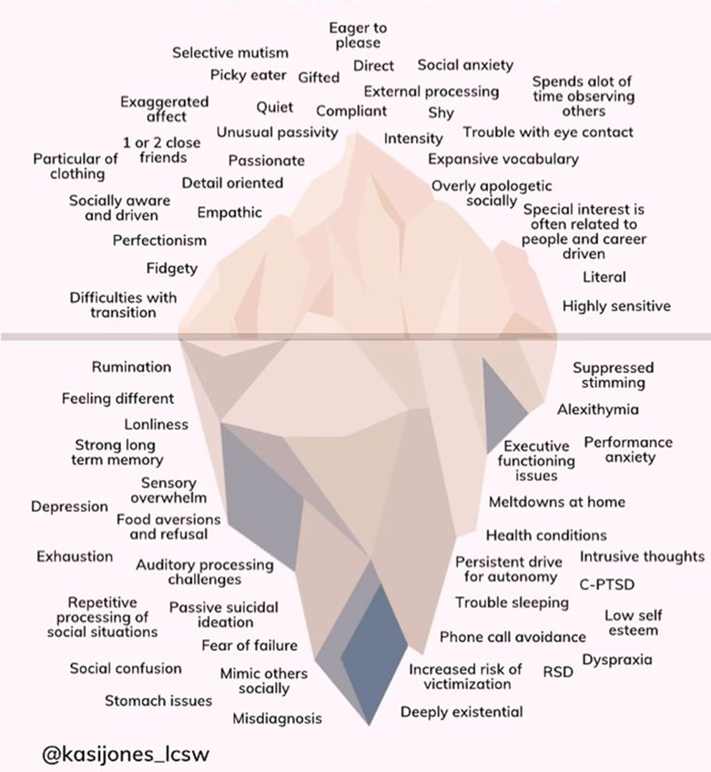
But…
… Arguably, even the first iceberg is masking!
Notes:
Courtney

Slide 7
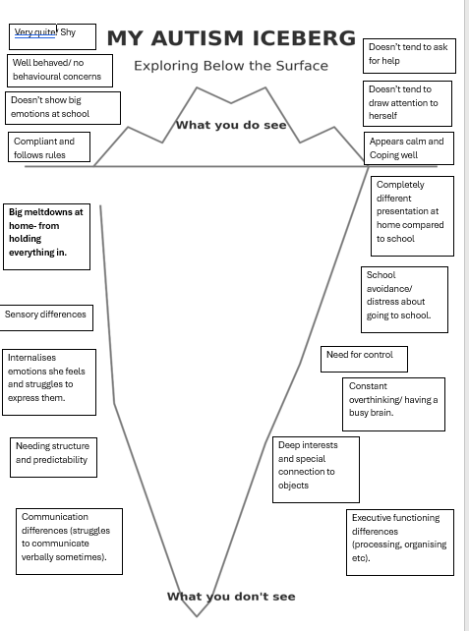
Notes:
Courtney- Example from work completed with parent and carer (case example).

Slide 8
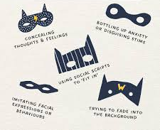
Masking may include…
… the skill needed to be able to observe, interpret and replicate behaviours is both impressive and exhausting
Notes:
Nat

Slide 9
Some examples of masking from our casework
Notes:
Sharing examples from casework… if anyone is happy to share?
Courtney
Nat

Slide 10
But why…?
Social Acceptance & Survival: Children mask to blend in, avoid being bullied, and prevent social exclusion.
Compliance with Expectations: It is a way to meet the often-high expectations of teachers and peers, such as sitting still, making eye contact, or mimicking social interactions.
Avoiding Negative Attention: It helps children avoid punishment or negative attention for behaviours like stimming (self-regulatory movements).
"Getting Through the Day": It acts as a coping mechanism to navigate a high-sensory environment, though this often leads to exhaustion, anxiety, or "autistic burnout" at home.
What is the function and/or purpose of masking?
Notes:
Lara

Slide 11

Masking in nature…
Geckos change colour to blend in.
Chameleons change colour to communicate or convey emotions which results in them becoming even more conspicuous.
Notes:
Lara
An example from one of our amazing young people…
… while gecko's are like chameleons, in that they can change colour, they do it for different reasons.
Geckos change colour to blend in, not only to avoid predators, but also, to catch prey.
Chameleons change colour to communicate or convey emotions which results in them becoming even more conspicuous.

Slide 12
The consequences of Masking:
For many children, masking feels like protection. It can help them feel safer, more socially accepted, or less exposed.
But maintaining this and the level of effort over time can have a real impact on there health and wellbeing.
Notes:
Courtney

Slide 13
The consequences of Masking:
Distressed behavior, including meltdowns and/or shutdowns (often only expressed when it can’t be held in any longer or when the individual feels safe enough in their environment to do so, such as when they get home from school)
mental and physical exhaustion (which can lead to autistic burnout)
mental health difficulties (including increased suicidality and/or self-harm).
isolation and/or feeling disconnected from other people
being more vulnerable to abuse (if you ‘blend in’ by overriding your reactions and going along with what other people want, this may not keep you safe in certain situations, such as sexual interactions)
a loss of sense of self
low self-esteem.
Increasing resistance to school or difficulty attending
Needs being missed because the child appears to be coping and a cycle of struggling
Physical symptoms such as headaches, stomach aches, or sleep difficulties
Notes:
Courtney

Slide 14
What is the one biggest thing we can do to support children/young people who are masking?
Notes:
Amy

Slide 15
…. Believe that it is happening!
Notes:
Amy
The goal is not to eliminate all masking, as it can be a helpful strategy for some AT TIMES. The goal is to reduce the need for it.

Slide 16
General strategies
Environment and Structure:
Predictability: Maintain a highly structured, predictable daily schedule to reduce anxiety.
Clear Transitions: Provide advance warning of changes to the routine.
Visual Supports: Use visual schedules and checklists to reduce reliance on verbal instructions.
Safe Spaces: Create quiet, low-sensory spaces where the child can "drop the mask"
Social and Emotional Support:
Trusted Adult Check-ins: Implement daily, brief (3-minute) check-ins with a familiar, nurturing adult.
Validate Feelings: Acknowledge that exhaustion after school is real and not just "being tired".
Interest-Based Socializing: Support friendships built on shared, specific interests rather than superficial social performance.
Show them it’s ok to be themselves: Actively show them that they are understood and valued as they are, not just when they are compliant or performing well.
Notes:
Nat
Try to be proactive rather than reactive: Because children who mask don’t always show us when they are struggling, it’s important that we act on our professional curiosity and put supports in place proactively, rather than waiting for them to reach a point of distress.

Slide 17
Instructional & Classroom Adaptations:
Sensory Breaks: Allow regular, proactive, scheduled sensory breaks to prevent burnout.
Reduced Demands: Minimize unnecessary social demands, such as forced eye contact or loud, group participation.
Pre-teaching: Offer, in advance, topics for discussion or upcoming changes to reduce the need for "scripting" (rehearsing what to say).
Whole-Class Implementation:
Strategies that support children who mask are often supportive for all pupils. Offering them universally reduces stigma and increases inclusion.
School-Home Collaboration:
Communication: Maintain regular communication with parents to understand if the child is crashing at home after appearing "fine" at school.
Advocacy: Use tools like the "Incredible 5 Point Scale" to help the child express their internal state, even if they appear calm outwardly.
General strategies
Notes:
Nat

Slide 18
… but how can we represent masking on the TREE (NDP referral) Form?
Notes:
Amy
Staff in schools often report that it can be difficult to make referrals to the Neuro team when children/young people are masking as they are not observing the behaviours within school. Here are a few things you might consider…

Slide 19
What you might see…
  They appear to play appropriately with available toys or activities
  They play with the other children around them
But consider…..
Do they initiate play, or mainly follow others’ ideas?
Do they prefer structured games over imaginative or unpredictable play?
Interests – are these just the ‘same’ as their peers? How intense is the interest?
Routines and rules – how do they respond when these change?
Do they appear watchful or hesitant before joining in?
Play/ Free
Time
Notes:
Amy

Slide 20
What might you see…
They have friends and are rarely alone
They work in pairs or groups without difficulty
They appear socially confident
But consider…
Do they initiate interactions or do they wait for others to initiate?
Can they respond appropriately?
Working in pairs/groups – how do they manage this? what role do they take?
Empathising with others – what does this look like?
Do they seem drained or tired after social times?
Interaction with others
Notes:
Amy

Slide 21
What you might see…
They are articulate and expressive
They respond appropriately in conversation
They use age-appropriate or advanced vocabulary
But consider…
Are they copying the language of others or using memorised lines or phrases?
Do they always understand what you are saying to them? What do they do if they don’t understand – do they ask for help?
Are they able to engage in reciprocal interactions? Are they just responding to others?
Conversation/ Language Use
Notes:
Amy

Slide 22
What you might see…
  They attend really well in class
  They are able to sit still and concentrate for extended periods of time
But…
When do they attend best?
Is there a change in their presentation/ energy following tasks that required high attention.
Are there behaviours they engage in when they are more relaxed (e.g. stimming) but then suppress them during other times?
Attention/ Activity Levels
Notes:
Amy

Slide 23
What you might see…
  They are very compliant and quiet
  They do not present any extremes of emotion
But…
Parents report that they are struggling to get them to school, in the morning
Parents report that they are experiencing extremes of emotion once they leave school
Is there a large difference in how parents report them to be at home compared to school?
Have you ever seen them express disappointment, frustration or sadness in school?
Emotional Wellbeing
Notes:
Amy

Slide 24
Activity: Have a go!
Notes:
Amy
Activity. On tables have referral forms – encourage SENCo’s to fill them in for a child/young person they know who they feel may be masking.
Is there any young people that have come to mind when we have gone through this?

Slide 25
Feedback
After completing the activity…
Any thoughts?
Any reflections?

Slide 26

Thank you
Any questions?

Slide 27
Resources:
https://www.autism.org.uk/advice-and-guidance/topics/behaviour/masking
https://www.kids.org.uk/guides/masking/
https://www.thirdspace.scot/wp-content/uploads/2022/09/NAIT-Guide-to-Autistic-Masking-for-Parents-and-Carers-2022.pdf
https://www.facebook.com/comfaclothing/videos/5-ways-to-know-your-child-is-masking-at-school-often-neurodivergent-kids-are-so-/1173813494856976/ - This link is on Facebook but is a really nice explanation by an autistic young person and family about what masking can look like in school.

