Slide 1
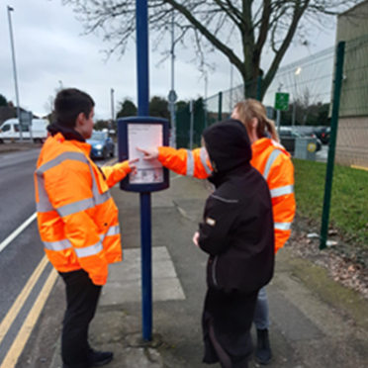
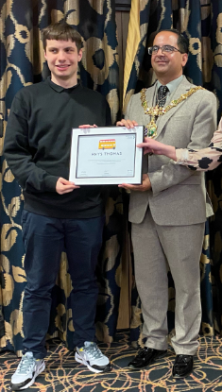
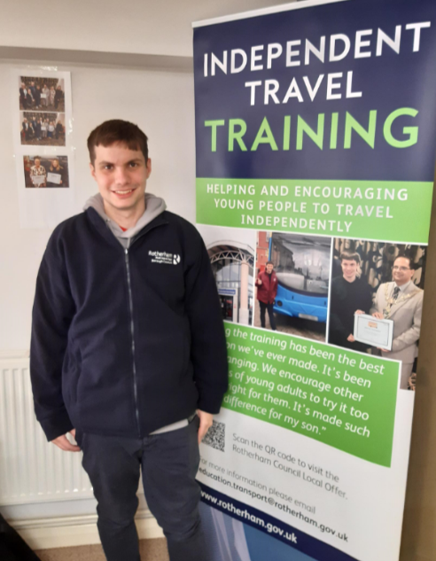
INDEPENDENT TRAVEL TRAINING
MY STORY
RHYS THOMAS

Slide 2
My experience in travel training
At First:
I was scared of being alone in the public.
Because in mornings it was always busy from where I travel.
This was a new experience for me as I never did all this before travel training.
Nervous but excited at the same time to start travel training. Wanted to use public transport to get to college and employment in the future.
Weird at first to get used to as the trainer is constantly around you and changing positions for different crossings.
After 2 weeks:
Started to gain to confidence slowly as the trainer slowly backed away from me.
Still nervous about doing it by myself. But Julie/College/Parents helped me by giving me encouragement and support throughout the training. Which helped me complete the route by myself as I progressed in the training.
Still wanted to have the trainer's presence for a while longer even though I could do the route by myself.
I’ve started to get settled with the bus being busy.
And started to be patient if the bus is running late or missing If One bus was missing or late, I just look at timetable and see if there's another bus I can get instead weather it’s busy or not.

Slide 3
And now
I am now completely independent to travel on my own and I now travel to college and 2 of my workplaces on my own
I have started to use Bustimes to track my bus and make sure its running on time
I've got used to it now with the bus being busy in mornings and afternoons and if the bus is full and standing
I just wait for the next one and let one of my colleagues at work or my mum know I’m going to be late
I also started using back up bus routes in case if my main bus route is missing or running late.

Slide 4
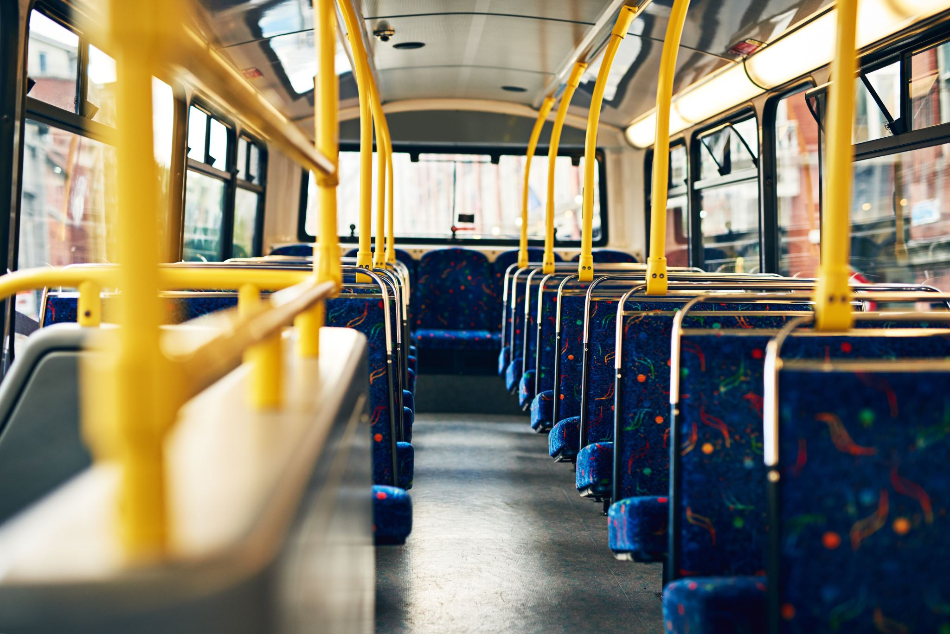
Independent Travel Training

Slide 5
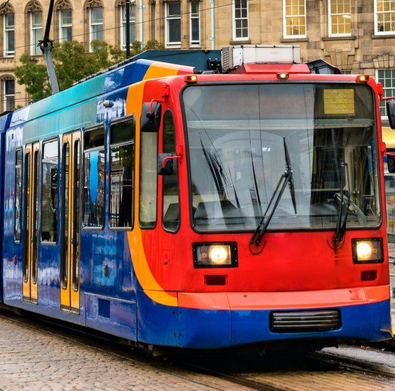
What is Independent Travel training?
Independent Travel Training Designed to help people get more out of life by giving them the confidence to travel independently to or from /school/college by bus, train, tram or taxi.

Slide 6
Personal safety
• Travel safety
• Travel skills
• Problem solving e.g. ‘what if’ situations
• Planning a journey e.g. identifying appropriate route, landmarks, timetable
• Communication e.g. understanding instructions, asking others for help.
When crossing the main road, watch out for moving vehicles, people who may look suspicious and any other risks that may harm you in any way.

Slide 7
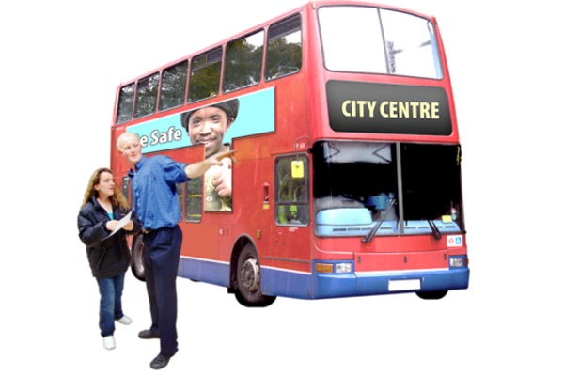
Buddy system
A ‘buddy system’ is when a trainee travels in pairs or small groups to help each other whenever they are out. They can alert each other to any dangers, and increase the enjoyment of travelling.
Also, find out if any other pupils are travelling this route and encourage them to ‘buddy up’ to help one another with personal safety.

Slide 8
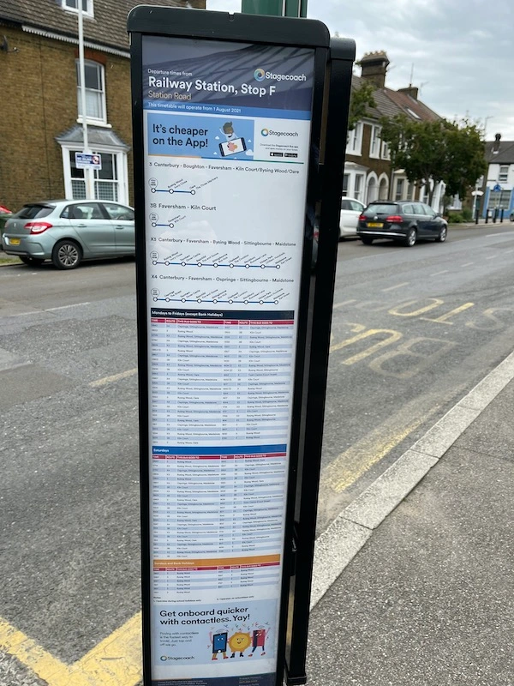
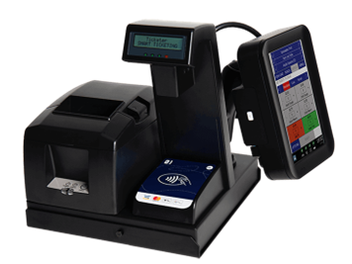
The process
The trainer will introduce themselves to the young person who wants to be trained.
2. They will ask you questions to see if you’re suitable for travel training and build your confidence up.
3. they will carry out a risk assessment for your own safety.
4. They will show you to the nearest bus stop if you’re travelling by bus and explain the bus routes and timetables.
5.If you have a bus pass, they will demonstrate how to use it and who to show it to when getting on the bus
6. Some buses have a scanning machine they will demonstrate how to scan your bus pass or bus ticket.
7. Then they will travel with you on the bus at the same time explaining the bus route and get off the bus from the nearest stop close to your home or school.
8. They will repeat this until you’re confident that you can carry out these tasks by yourself.
9. They will shadow you and see if you can do this on your own and will only withdraw once you feel safe and confident.
10. This can take any amount of time depending on each student’s needs.

Slide 9
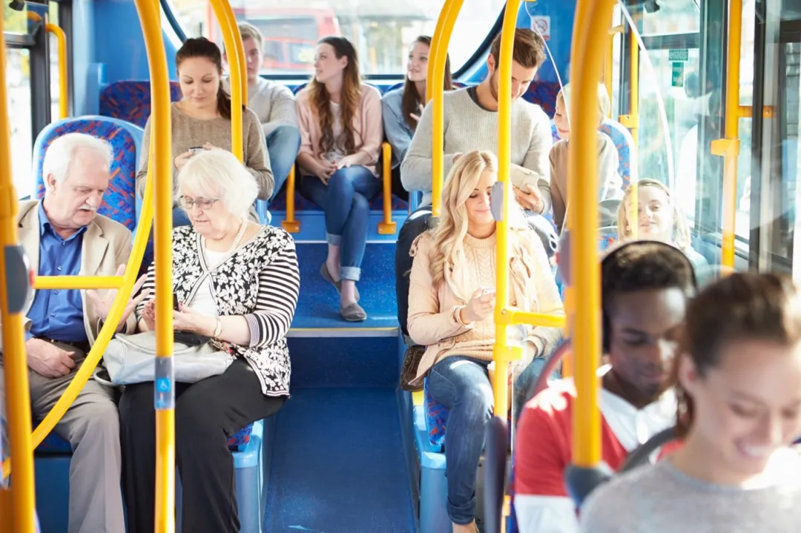
Remember the trainers will only leave you once you’re confident that you can travel by yourself.

